Slide 1
Where does the error come from?
Notes:
http://cs229.stanford.edu/materials/ML-advice.pdf

Slide 2
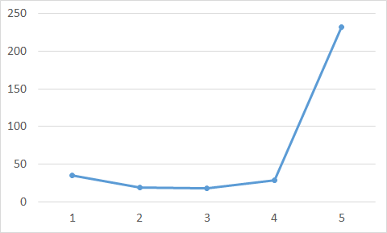
Review
Average Error on Testing Data
error due to "bias" and error due to "variance"
A more complex model does not always lead to better performance on testing data.
Notes:
bias 偏见，偏差
variance 方差
Estimator 估计量
unbiased 无偏见的
Parallel Universes 平行宇宙
In all the universes, we are collecting (catching) 10 Pokémons as training data to find 𝑓^∗ 在所有的宇宙中，我们收集（捕捉）10个poksamons作为训练数据来找到𝑓^ *
Simpler model is less influenced by the sampled data 简单的模型受采样数据的影响较小
Consider the extreme case f(x) = c 考虑极端情况f(x) = c
Underfitting 欠拟合
Diagnosis: 诊断：
If your model cannot even fit the training examples, then you have large bias 如果您的模型甚至无法拟合训练样本，那么您存在较大的偏差。
If you can fit the training data, but large error on testing data, then you probably have large variance 如果您能够拟合训练数据，但在测试数据上存在较大误差，那么您可能具有较大的方差。
For bias, redesign your model: 对于偏差，重新设计您的模型：
Add more features as input 增加更多的输入特征
A more complex model 使用更复杂的模型
Very effective, but not always practical 非常有效，但并不总是实用
Regularization 正则化

Slide 3
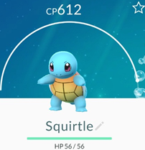
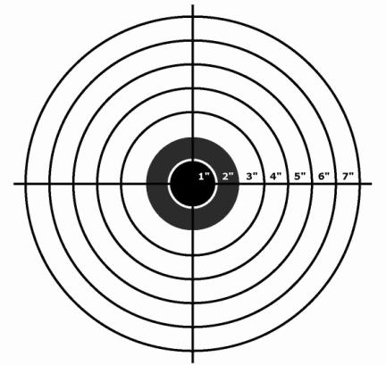
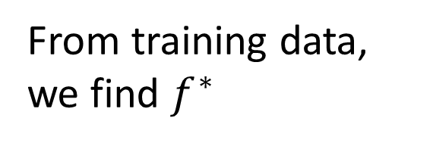
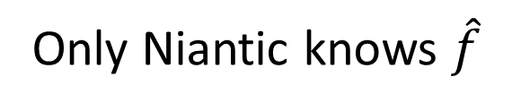
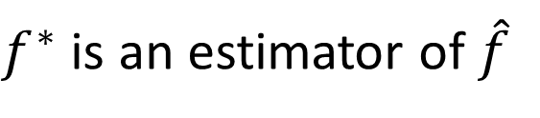



Estimator
Bias + Variance
$$f^{∗}$$
$$\hat{y}=\hat{f}\left( \right)$$
Only Niantic knows $\hat{f}$
From training data, we find $f^{∗}$
$$\hat{f}$$
$f^{∗}$ is an estimator of $\hat{f}$
Notes:
bias 偏见，偏差
variance 方差
Estimator 估计量
unbiased 无偏见的
Parallel Universes 平行宇宙
In all the universes, we are collecting (catching) 10 Pokémons as training data to find 𝑓^∗ 在所有的宇宙中，我们收集（捕捉）10个poksamons作为训练数据来找到𝑓^ *
Simpler model is less influenced by the sampled data 简单的模型受采样数据的影响较小
Consider the extreme case f(x) = c 考虑极端情况f(x) = c
Underfitting 欠拟合
Diagnosis: 诊断：
If your model cannot even fit the training examples, then you have large bias 如果您的模型甚至无法拟合训练样本，那么您存在较大的偏差。
If you can fit the training data, but large error on testing data, then you probably have large variance 如果您能够拟合训练数据，但在测试数据上存在较大误差，那么您可能具有较大的方差。
For bias, redesign your model: 对于偏差，重新设计您的模型：
Add more features as input 增加更多的输入特征
A more complex model 使用更复杂的模型
Very effective, but not always practical 非常有效，但并不总是实用
Regularization 正则化

Slide 4
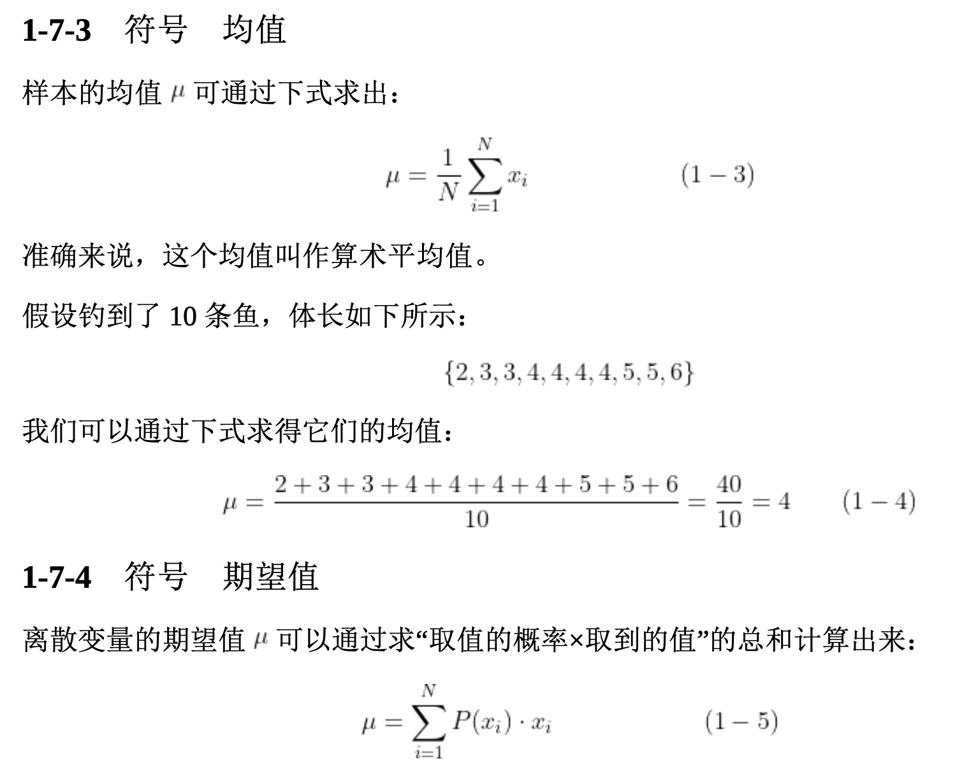
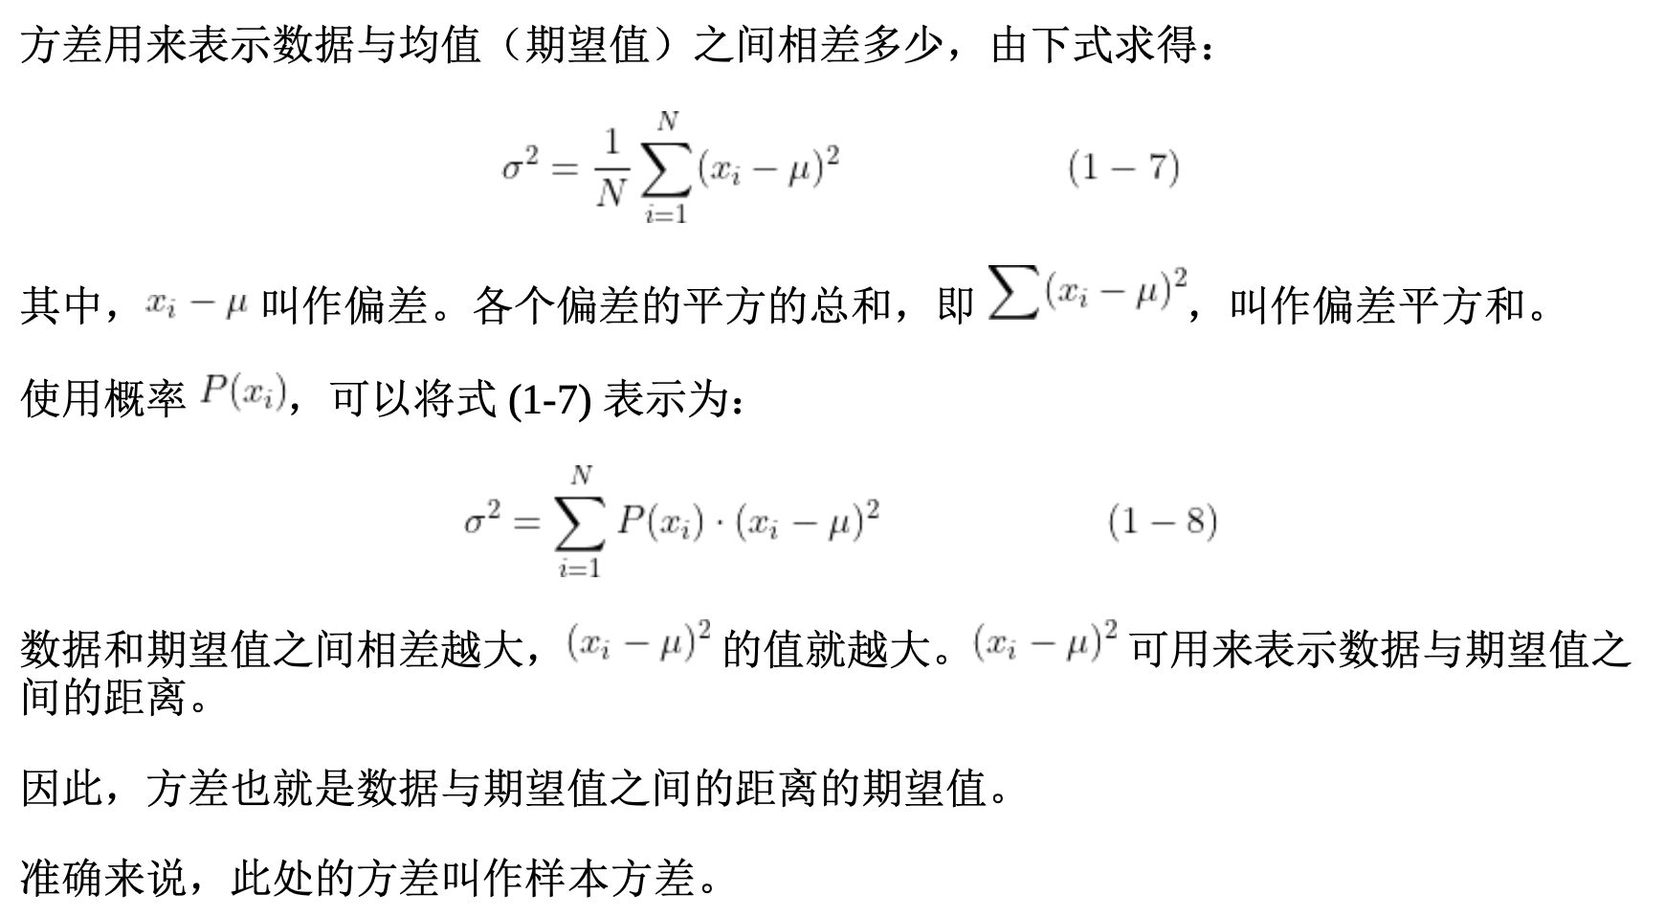
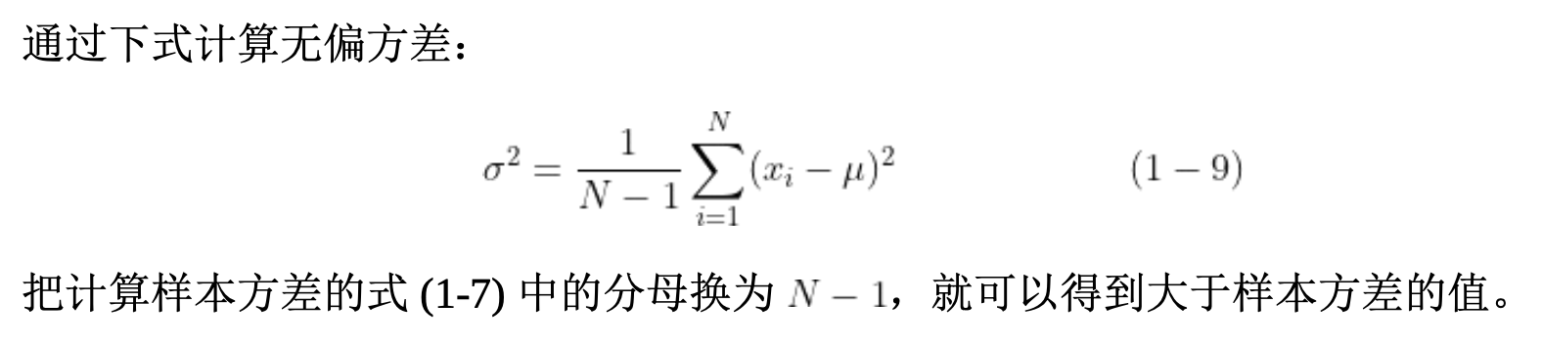
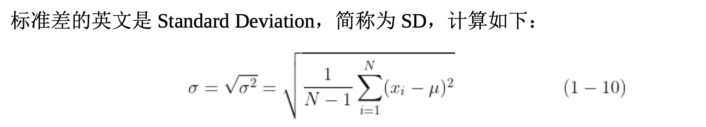

Slide 5













Bias and Variance of Estimator
unbiased
Estimate the mean of a variable x
assume the mean of x is $μ$
assume the variance of x is $σ^{2}$
Estimator of mean $μ$
Sample N points: $\left\{x^{1},x^{2},…,x^{N}\right\}$
$$m_{2}$$
$$m_{5}$$
$$m_{1}$$
$$μ$$
$$m=\frac{1}{N}\sum_{n}{x^{n}}$$
$$≠μ$$
$$m_{4}$$
$$m_{3}$$
$$E\left[m\right]=E\left[\frac{1}{N}\sum_{n}{x^{n}}\right]$$
$$=\frac{1}{N}\sum_{n}{E\left[x^{n}\right]}$$
$$=μ$$
$$m_{6}$$
Notes:
bias 偏见，偏差
variance 方差
Estimator 估计量
Estimate the mean of a variable x 估计变量x的均值
assume the mean of x is 𝜇 假设均值
assume the variance of x is 𝜎^2 假设方差
m 表示算术平均值
𝐸[𝑚] 表示期望值
unbiased 无偏见的
Parallel Universes 平行宇宙
In all the universes, we are collecting (catching) 10 Pokémons as training data to find 𝑓^∗ 在所有的宇宙中，我们收集（捕捉）10个poksamons作为训练数据来找到𝑓^ *
Simpler model is less influenced by the sampled data 简单的模型受采样数据的影响较小
Consider the extreme case f(x) = c 考虑极端情况f(x) = c
Underfitting 欠拟合
Diagnosis: 诊断：
If your model cannot even fit the training examples, then you have large bias 如果您的模型甚至无法拟合训练样本，那么您存在较大的偏差。
If you can fit the training data, but large error on testing data, then you probably have large variance 如果您能够拟合训练数据，但在测试数据上存在较大误差，那么您可能具有较大的方差。
For bias, redesign your model: 对于偏差，重新设计您的模型：
Add more features as input 增加更多的输入特征
A more complex model 使用更复杂的模型
Very effective, but not always practical 非常有效，但并不总是实用
Regularization 正则化

Slide 6




Bias and Variance of Estimator
unbiased
Estimate the mean of a variable x
assume the mean of x is $μ$
assume the variance of x is $σ^{2}$
Estimator of mean $μ$
Sample N points: $\left\{x^{1},x^{2},…,x^{N}\right\}$
Smaller N
Larger N
$$m=\frac{1}{N}\sum_{n}{x^{n}}$$
$$≠μ$$
$$μ$$
$$μ$$
Variance depends on the number of samples
$$Var\left[m\right]=\frac{σ^{2}}{N}$$
Notes:
bias 偏见，偏差
variance 方差
Estimator 估计量
Estimate the mean of a variable x 估计变量x的均值
assume the mean of x is 𝜇 假设均值
assume the variance of x is 𝜎^2 假设方差
m 表示算术平均值
𝐸[𝑚] 表示期望值
unbiased 无偏见的
V𝑎𝑟[𝑚] 表示 m 的方差
Parallel Universes 平行宇宙
In all the universes, we are collecting (catching) 10 Pokémons as training data to find 𝑓^∗ 在所有的宇宙中，我们收集（捕捉）10个poksamons作为训练数据来找到𝑓^ *
Simpler model is less influenced by the sampled data 简单的模型受采样数据的影响较小
Consider the extreme case f(x) = c 考虑极端情况f(x) = c
Underfitting 欠拟合
Diagnosis: 诊断：
If your model cannot even fit the training examples, then you have large bias 如果您的模型甚至无法拟合训练样本，那么您存在较大的偏差。
If you can fit the training data, but large error on testing data, then you probably have large variance 如果您能够拟合训练数据，但在测试数据上存在较大误差，那么您可能具有较大的方差。
For bias, redesign your model: 对于偏差，重新设计您的模型：
Add more features as input 增加更多的输入特征
A more complex model 使用更复杂的模型
Very effective, but not always practical 非常有效，但并不总是实用
Regularization 正则化

Slide 7








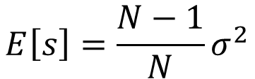




Bias and Variance of Estimator
Increase N
Estimate the mean of a variable x
assume the mean of x is $μ$
assume the variance of x is $σ^{2}$
Estimator of variance $σ^{2}$
Sample N points: $\left\{x^{1},x^{2},…,x^{N}\right\}$
$$s_{3}$$
$$σ^{2}$$
$$σ^{2}$$
$$s_{1}$$
$$m=\frac{1}{N}\sum_{n}{x^{n}}$$
$$s=\frac{1}{N}\sum_{n}{{\left(x^{n}−m\right)}^{2}}$$
$$s_{4}$$
$$s_{5}$$
Biased estimator
$$s_{2}$$
$$s_{6}$$
$$E\left[s\right]=\frac{N−1}{N}σ^{2}$$
$$≠σ^{2}$$
Notes:
bias 偏见，偏差
variance 方差
Estimator 估计量
Estimate the mean of a variable x 估计变量x的均值
assume the mean of x is 𝜇 假设均值
assume the variance of x is 𝜎^2 假设方差
m 表示算术平均值
𝐸[𝑚] 表示期望值
unbiased 无偏见的
V𝑎𝑟[𝑚] 表示 m 的方差
s 表示方差
𝐸[s] 表示 s 的期望值
Parallel Universes 平行宇宙
In all the universes, we are collecting (catching) 10 Pokémons as training data to find 𝑓^∗ 在所有的宇宙中，我们收集（捕捉）10个poksamons作为训练数据来找到𝑓^ *
Simpler model is less influenced by the sampled data 简单的模型受采样数据的影响较小
Consider the extreme case f(x) = c 考虑极端情况f(x) = c
Underfitting 欠拟合
Diagnosis: 诊断：
If your model cannot even fit the training examples, then you have large bias 如果您的模型甚至无法拟合训练样本，那么您存在较大的偏差。
If you can fit the training data, but large error on testing data, then you probably have large variance 如果您能够拟合训练数据，但在测试数据上存在较大误差，那么您可能具有较大的方差。
For bias, redesign your model: 对于偏差，重新设计您的模型：
Add more features as input 增加更多的输入特征
A more complex model 使用更复杂的模型
Very effective, but not always practical 非常有效，但并不总是实用
Regularization 正则化

Slide 8
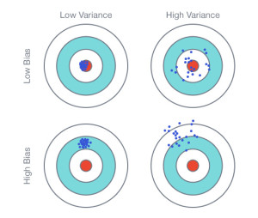



$$E\left[f^{∗}\right]=\overline{f}$$
$$f^{∗}$$
Variance
Bias
$$\hat{f}$$
Notes:
bias 偏见，偏差
variance 方差
Estimator 估计量
Estimate the mean of a variable x 估计变量x的均值
assume the mean of x is 𝜇 假设均值
assume the variance of x is 𝜎^2 假设方差
m 表示算术平均值
𝐸[𝑚] 表示期望值
unbiased 无偏见的
V𝑎𝑟[𝑚] 表示 m 的方差
s 表示方差
𝐸[s] 表示 s 的期望值
If we can do the experiments several times
Parallel Universes 平行宇宙
In all the universes, we are collecting (catching) 10 Pokémons as training data to find 𝑓^∗ 在所有的宇宙中，我们收集（捕捉）10个poksamons作为训练数据来找到𝑓^ *
Simpler model is less influenced by the sampled data 简单的模型受采样数据的影响较小
Consider the extreme case f(x) = c 考虑极端情况f(x) = c
Underfitting 欠拟合
Diagnosis: 诊断：
If your model cannot even fit the training examples, then you have large bias 如果您的模型甚至无法拟合训练样本，那么您存在较大的偏差。
If you can fit the training data, but large error on testing data, then you probably have large variance 如果您能够拟合训练数据，但在测试数据上存在较大误差，那么您可能具有较大的方差。
For bias, redesign your model: 对于偏差，重新设计您的模型：
Add more features as input 增加更多的输入特征
A more complex model 使用更复杂的模型
Very effective, but not always practical 非常有效，但并不总是实用
Regularization 正则化

Slide 9
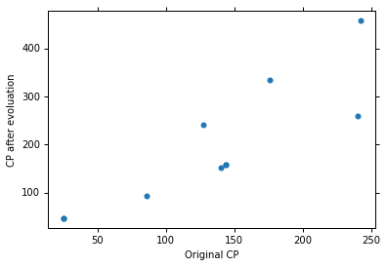
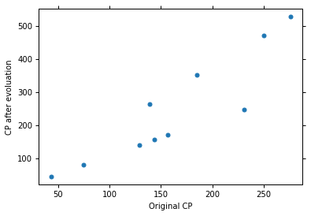
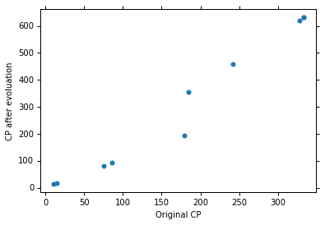
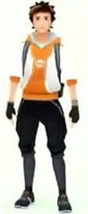
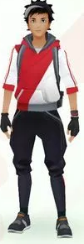
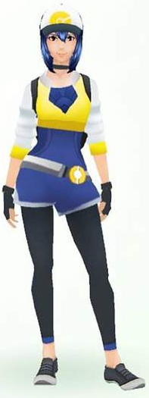

Parallel Universes
In all the universes, we are collecting (catching) 10 Pokémons as training data to find $f^{∗}$
Universe 1
Universe 2
Universe 3
Notes:
bias 偏见，偏差
variance 方差
Estimator 估计量
Estimate the mean of a variable x 估计变量x的均值
assume the mean of x is 𝜇 假设均值
assume the variance of x is 𝜎^2 假设方差
m 表示算术平均值
𝐸[𝑚] 表示期望值
unbiased 无偏见的
V𝑎𝑟[𝑚] 表示 m 的方差
s 表示方差
𝐸[s] 表示 s 的期望值
If we can do the experiments several times
Parallel Universes 平行宇宙
In all the universes, we are collecting (catching) 10 Pokémons as training data to find 𝑓^∗ 在所有的宇宙中，我们收集（捕捉）10个poksamons作为训练数据来找到𝑓^ *
Simpler model is less influenced by the sampled data 简单的模型受采样数据的影响较小
Consider the extreme case f(x) = c 考虑极端情况f(x) = c
Underfitting 欠拟合
Diagnosis: 诊断：
If your model cannot even fit the training examples, then you have large bias 如果您的模型甚至无法拟合训练样本，那么您存在较大的偏差。
If you can fit the training data, but large error on testing data, then you probably have large variance 如果您能够拟合训练数据，但在测试数据上存在较大误差，那么您可能具有较大的方差。
For bias, redesign your model: 对于偏差，重新设计您的模型：
Add more features as input 增加更多的输入特征
A more complex model 使用更复杂的模型
Very effective, but not always practical 非常有效，但并不总是实用
Regularization 正则化

Slide 10
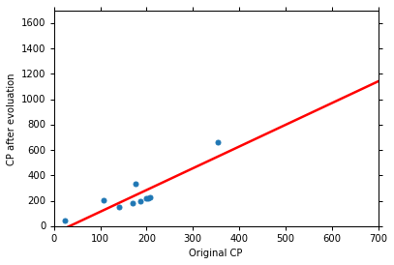
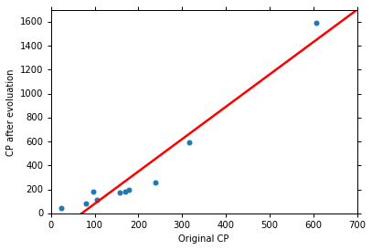

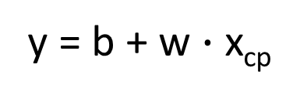
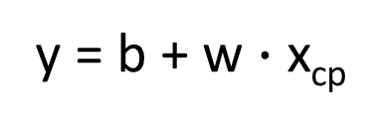
Parallel Universes
In different universes, we use the same model, but obtain different $f^{∗}$
Universe 123
Universe 345
y = b + w $∙$ x_{cp}
y = b + w $∙$ x_{cp}
Notes:
bias 偏见，偏差
variance 方差
Estimator 估计量
Estimate the mean of a variable x 估计变量x的均值
assume the mean of x is 𝜇 假设均值
assume the variance of x is 𝜎^2 假设方差
m 表示算术平均值
𝐸[𝑚] 表示期望值
unbiased 无偏见的
V𝑎𝑟[𝑚] 表示 m 的方差
s 表示方差
𝐸[s] 表示 s 的期望值
If we can do the experiments several times
Parallel Universes 平行宇宙
In all the universes, we are collecting (catching) 10 Pokémons as training data to find 𝑓^∗ 在所有的宇宙中，我们收集（捕捉）10个poksamons作为训练数据来找到𝑓^ *
Simpler model is less influenced by the sampled data 简单的模型受采样数据的影响较小
Consider the extreme case f(x) = c 考虑极端情况f(x) = c
Underfitting 欠拟合
Diagnosis: 诊断：
If your model cannot even fit the training examples, then you have large bias 如果您的模型甚至无法拟合训练样本，那么您存在较大的偏差。
If you can fit the training data, but large error on testing data, then you probably have large variance 如果您能够拟合训练数据，但在测试数据上存在较大误差，那么您可能具有较大的方差。
For bias, redesign your model: 对于偏差，重新设计您的模型：
Add more features as input 增加更多的输入特征
A more complex model 使用更复杂的模型
Very effective, but not always practical 非常有效，但并不总是实用
Regularization 正则化

Slide 11
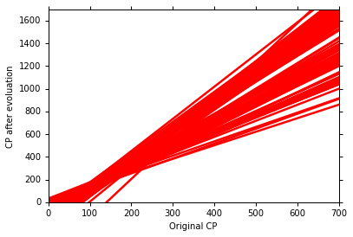
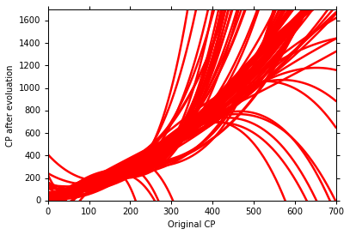
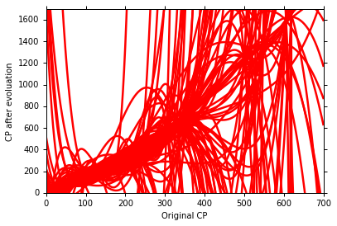
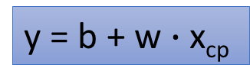
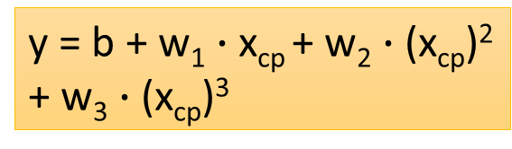
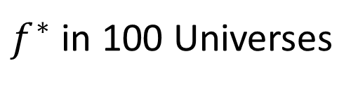
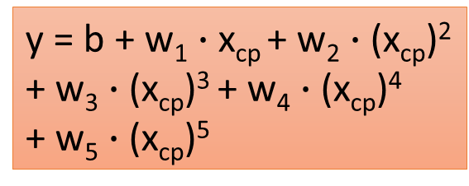
$f^{∗}$ in 100 Universes
y = b + w $∙$ x_{cp}
y = b + w₁ $∙$ x_{cp} + w₂ $∙$ (x_{cp})²
+ w₃ $∙$ (x_{cp})³
y = b + w₁ $∙$ x_{cp} + w₂ $∙$ (x_{cp})²
+ w₃ $∙$ (x_{cp})³ + w₄ $∙$ (x_{cp})⁴
+ w₅ $∙$ (x_{cp})⁵
Notes:
bias 偏见，偏差
variance 方差
Estimator 估计量
Estimate the mean of a variable x 估计变量x的均值
assume the mean of x is 𝜇 假设均值
assume the variance of x is 𝜎^2 假设方差
m 表示算术平均值
𝐸[𝑚] 表示期望值
unbiased 无偏见的
V𝑎𝑟[𝑚] 表示 m 的方差
s 表示方差
𝐸[s] 表示 s 的期望值
If we can do the experiments several times
Parallel Universes 平行宇宙
In all the universes, we are collecting (catching) 10 Pokémons as training data to find 𝑓^∗ 在所有的宇宙中，我们收集（捕捉）10个poksamons作为训练数据来找到𝑓^ *
Simpler model is less influenced by the sampled data 简单的模型受采样数据的影响较小
Consider the extreme case f(x) = c 考虑极端情况f(x) = c
Underfitting 欠拟合
Diagnosis: 诊断：
If your model cannot even fit the training examples, then you have large bias 如果您的模型甚至无法拟合训练样本，那么您存在较大的偏差。
If you can fit the training data, but large error on testing data, then you probably have large variance 如果您能够拟合训练数据，但在测试数据上存在较大误差，那么您可能具有较大的方差。
For bias, redesign your model: 对于偏差，重新设计您的模型：
Add more features as input 增加更多的输入特征
A more complex model 使用更复杂的模型
Very effective, but not always practical 非常有效，但并不总是实用
Regularization 正则化

Slide 12

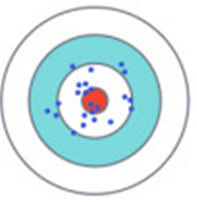

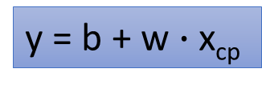
Variance
y = b + w₁ $∙$ x_{cp} + w₂ $∙$ (x_{cp})²
+ w₃ $∙$ (x_{cp})³ + w₄ $∙$ (x_{cp})⁴
+ w₅ $∙$ (x_{cp})⁵
y = b + w $∙$ x_{cp}
Small
Variance
Large
Variance
Simpler model is less influenced by the sampled data
Consider the extreme case f(x) = 5
Notes:
bias 偏见，偏差
variance 方差
Estimator 估计量
Estimate the mean of a variable x 估计变量x的均值
assume the mean of x is 𝜇 假设均值
assume the variance of x is 𝜎^2 假设方差
m 表示算术平均值
𝐸[𝑚] 表示期望值
unbiased 无偏见的
V𝑎𝑟[𝑚] 表示 m 的方差
s 表示方差
𝐸[s] 表示 s 的期望值
If we can do the experiments several times
Parallel Universes 平行宇宙
In all the universes, we are collecting (catching) 10 Pokémons as training data to find 𝑓^∗ 在所有的宇宙中，我们收集（捕捉）10个poksamons作为训练数据来找到𝑓^ *
Simpler model is less influenced by the sampled data 简单的模型受采样数据的影响较小
Consider the extreme case f(x) = c 考虑极端情况f(x) = c
Underfitting 欠拟合
Diagnosis: 诊断：
If your model cannot even fit the training examples, then you have large bias 如果您的模型甚至无法拟合训练样本，那么您存在较大的偏差。
If you can fit the training data, but large error on testing data, then you probably have large variance 如果您能够拟合训练数据，但在测试数据上存在较大误差，那么您可能具有较大的方差。
For bias, redesign your model: 对于偏差，重新设计您的模型：
Add more features as input 增加更多的输入特征
A more complex model 使用更复杂的模型
Very effective, but not always practical 非常有效，但并不总是实用
Regularization 正则化

Slide 13
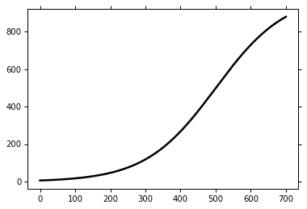


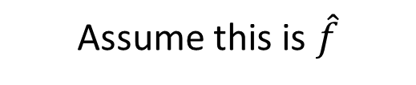
Bias
$$E\left[f^{∗}\right]=\overline{f}$$
Bias: If we average all the $f^{∗}$, is it close to $\hat{f}$ ?
Large
Bias
Assume this is $\hat{f}$
Small
Bias
Notes:
bias 偏见，偏差
variance 方差
Estimator 估计量
Estimate the mean of a variable x 估计变量x的均值
assume the mean of x is 𝜇 假设均值
assume the variance of x is 𝜎^2 假设方差
m 表示算术平均值
𝐸[𝑚] 表示期望值
unbiased 无偏见的
V𝑎𝑟[𝑚] 表示 m 的方差
s 表示方差
𝐸[s] 表示 s 的期望值
If we can do the experiments several times
Parallel Universes 平行宇宙
In all the universes, we are collecting (catching) 10 Pokémons as training data to find 𝑓^∗ 在所有的宇宙中，我们收集（捕捉）10个poksamons作为训练数据来找到𝑓^ *
Simpler model is less influenced by the sampled data 简单的模型受采样数据的影响较小
Consider the extreme case f(x) = c 考虑极端情况f(x) = c
We don’t really know the F^
Underfitting 欠拟合
Diagnosis: 诊断：
If your model cannot even fit the training examples, then you have large bias 如果您的模型甚至无法拟合训练样本，那么您存在较大的偏差。
If you can fit the training data, but large error on testing data, then you probably have large variance 如果您能够拟合训练数据，但在测试数据上存在较大误差，那么您可能具有较大的方差。
For bias, redesign your model: 对于偏差，重新设计您的模型：
Add more features as input 增加更多的输入特征
A more complex model 使用更复杂的模型
Very effective, but not always practical 非常有效，但并不总是实用
Regularization 正则化

Slide 14
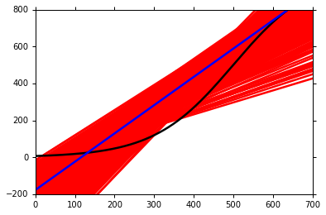
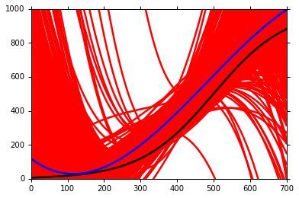
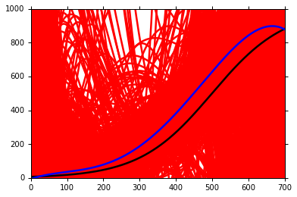

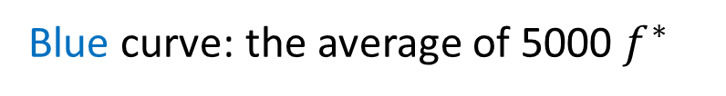
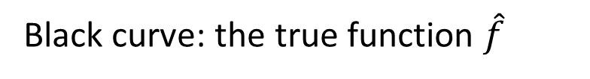

Black curve: the true function $\hat{f}$
Red curves: 5000 $f^{∗}$
Blue curve: the average of 5000 $f^{∗}$
$$=\overline{f}$$
Notes:
bias 偏见，偏差
variance 方差
Estimator 估计量
Estimate the mean of a variable x 估计变量x的均值
assume the mean of x is 𝜇 假设均值
assume the variance of x is 𝜎^2 假设方差
m 表示算术平均值
𝐸[𝑚] 表示期望值
unbiased 无偏见的
V𝑎𝑟[𝑚] 表示 m 的方差
s 表示方差
𝐸[s] 表示 s 的期望值
If we can do the experiments several times
Parallel Universes 平行宇宙
In all the universes, we are collecting (catching) 10 Pokémons as training data to find 𝑓^∗ 在所有的宇宙中，我们收集（捕捉）10个poksamons作为训练数据来找到𝑓^ *
Simpler model is less influenced by the sampled data 简单的模型受采样数据的影响较小
Consider the extreme case f(x) = c 考虑极端情况f(x) = c
We don’t really know the F^
Underfitting 欠拟合
Diagnosis: 诊断：
If your model cannot even fit the training examples, then you have large bias 如果您的模型甚至无法拟合训练样本，那么您存在较大的偏差。
If you can fit the training data, but large error on testing data, then you probably have large variance 如果您能够拟合训练数据，但在测试数据上存在较大误差，那么您可能具有较大的方差。
For bias, redesign your model: 对于偏差，重新设计您的模型：
Add more features as input 增加更多的输入特征
A more complex model 使用更复杂的模型
Very effective, but not always practical 非常有效，但并不总是实用
Regularization 正则化

Slide 15

Bias
y = b + w₁ $∙$ x_{cp} + w₂ $∙$ (x_{cp})²
+ w₃ $∙$ (x_{cp})³ + w₄ $∙$ (x_{cp})⁴
+ w₅ $∙$ (x_{cp})⁵
y = b + w $∙$ x_{cp}
Large
Bias
Small
Bias
model
model
Notes:
bias 偏见，偏差
variance 方差
Estimator 估计量
Estimate the mean of a variable x 估计变量x的均值
assume the mean of x is 𝜇 假设均值
assume the variance of x is 𝜎^2 假设方差
m 表示算术平均值
𝐸[𝑚] 表示期望值
unbiased 无偏见的
V𝑎𝑟[𝑚] 表示 m 的方差
s 表示方差
𝐸[s] 表示 s 的期望值
If we can do the experiments several times
Parallel Universes 平行宇宙
In all the universes, we are collecting (catching) 10 Pokémons as training data to find 𝑓^∗ 在所有的宇宙中，我们收集（捕捉）10个poksamons作为训练数据来找到𝑓^ *
Simpler model is less influenced by the sampled data 简单的模型受采样数据的影响较小
Consider the extreme case f(x) = c 考虑极端情况f(x) = c
We don’t really know the F^
Underfitting 欠拟合
Diagnosis: 诊断：
If your model cannot even fit the training examples, then you have large bias 如果您的模型甚至无法拟合训练样本，那么您存在较大的偏差。
If you can fit the training data, but large error on testing data, then you probably have large variance 如果您能够拟合训练数据，但在测试数据上存在较大误差，那么您可能具有较大的方差。
For bias, redesign your model: 对于偏差，重新设计您的模型：
Add more features as input 增加更多的输入特征
A more complex model 使用更复杂的模型
Very effective, but not always practical 非常有效，但并不总是实用
Regularization 正则化

Slide 16
Bias v.s. Variance
Error from bias
Error from variance
Error observed
Underfitting
Overfitting
Large Bias
Small Bias
Small Variance
Large Variance
Notes:
bias 偏见，偏差
variance 方差
Estimator 估计量
Estimate the mean of a variable x 估计变量x的均值
assume the mean of x is 𝜇 假设均值
assume the variance of x is 𝜎^2 假设方差
m 表示算术平均值
𝐸[𝑚] 表示期望值
unbiased 无偏见的
V𝑎𝑟[𝑚] 表示 m 的方差
s 表示方差
𝐸[s] 表示 s 的期望值
If we can do the experiments several times
Parallel Universes 平行宇宙
In all the universes, we are collecting (catching) 10 Pokémons as training data to find 𝑓^∗ 在所有的宇宙中，我们收集（捕捉）10个poksamons作为训练数据来找到𝑓^ *
Simpler model is less influenced by the sampled data 简单的模型受采样数据的影响较小
Consider the extreme case f(x) = c 考虑极端情况f(x) = c
We don’t really know the F^
Overfitting过度拟合
Underfitting 欠拟合
Diagnosis: 诊断：
If your model cannot even fit the training examples, then you have large bias 如果您的模型甚至无法拟合训练样本，那么您存在较大的偏差。
If you can fit the training data, but large error on testing data, then you probably have large variance 如果您能够拟合训练数据，但在测试数据上存在较大误差，那么您可能具有较大的方差。
For bias, redesign your model: 对于偏差，重新设计您的模型：
Add more features as input 增加更多的输入特征
A more complex model 使用更复杂的模型
Very effective, but not always practical 非常有效，但并不总是实用
Regularization 正则化

Slide 17
What to do with large bias?
Diagnosis:
If your model cannot even fit the training examples, then you have large bias
If you can fit the training data, but large error on testing data, then you probably have large variance
For bias, redesign your model:
Add more features as input
A more complex model
Underfitting
Overfitting
large bias
Notes:
bias 偏见，偏差
variance 方差
Estimator 估计量
Estimate the mean of a variable x 估计变量x的均值
assume the mean of x is 𝜇 假设均值
assume the variance of x is 𝜎^2 假设方差
m 表示算术平均值
𝐸[𝑚] 表示期望值
unbiased 无偏见的
V𝑎𝑟[𝑚] 表示 m 的方差
s 表示方差
𝐸[s] 表示 s 的期望值
If we can do the experiments several times
Parallel Universes 平行宇宙
In all the universes, we are collecting (catching) 10 Pokémons as training data to find 𝑓^∗ 在所有的宇宙中，我们收集（捕捉）10个poksamons作为训练数据来找到𝑓^ *
Simpler model is less influenced by the sampled data 简单的模型受采样数据的影响较小
Consider the extreme case f(x) = c 考虑极端情况f(x) = c
We don’t really know the F^
Overfitting过度拟合
Underfitting 欠拟合
Diagnosis: 诊断
If your model cannot even fit the training examples, then you have large bias 如果您的模型甚至无法拟合训练样本，那么您存在较大的偏差。
If you can fit the training data, but large error on testing data, then you probably have large variance 如果您能够拟合训练数据，但在测试数据上存在较大误差，那么您可能具有较大的方差。
For bias, redesign your model: 对于偏差，重新设计您的模型：
Add more features as input 增加更多的输入特征
A more complex model 使用更复杂的模型
Very effective, but not always practical 非常有效，但并不总是实用
Regularization 正则化

Slide 18




What to do with large variance?
More data
Regularization
Very effective, but not always practical
10 examples
100 examples
May increase bias
Notes:
bias 偏见，偏差
variance 方差
Estimator 估计量
Estimate the mean of a variable x 估计变量x的均值
assume the mean of x is 𝜇 假设均值
assume the variance of x is 𝜎^2 假设方差
m 表示算术平均值
𝐸[𝑚] 表示期望值
unbiased 无偏见的
V𝑎𝑟[𝑚] 表示 m 的方差
s 表示方差
𝐸[s] 表示 s 的期望值
If we can do the experiments several times
Parallel Universes 平行宇宙
In all the universes, we are collecting (catching) 10 Pokémons as training data to find 𝑓^∗ 在所有的宇宙中，我们收集（捕捉）10个poksamons作为训练数据来找到𝑓^ *
Simpler model is less influenced by the sampled data 简单的模型受采样数据的影响较小
Consider the extreme case f(x) = c 考虑极端情况f(x) = c
We don’t really know the F^
Overfitting过度拟合
Underfitting 欠拟合
Diagnosis: 诊断
If your model cannot even fit the training examples, then you have large bias 如果您的模型甚至无法拟合训练样本，那么您存在较大的偏差。
If you can fit the training data, but large error on testing data, then you probably have large variance 如果您能够拟合训练数据，但在测试数据上存在较大误差，那么您可能具有较大的方差。
For bias, redesign your model: 对于偏差，重新设计您的模型：
Add more features as input 增加更多的输入特征
A more complex model 使用更复杂的模型
Very effective, but not always practical 非常有效，但并不总是实用
Regularization 正则化

Slide 19
Model Selection
There is usually a trade-off between bias and variance.
Select a model that balances two kinds of error to minimize total error
What you should NOT do:
Training Set
Testing Set
Real Testing Set
Model 1
Err = 0.9
(not in hand)
Model 2
Err = 0.7
Model 3
Err = 0.5
Err > 0.5
Notes:
bias 偏见，偏差
variance 方差
Estimator 估计量
Estimate the mean of a variable x 估计变量x的均值
assume the mean of x is 𝜇 假设均值
assume the variance of x is 𝜎^2 假设方差
m 表示算术平均值
𝐸[𝑚] 表示期望值
unbiased 无偏见的
V𝑎𝑟[𝑚] 表示 m 的方差
s 表示方差
𝐸[s] 表示 s 的期望值
If we can do the experiments several times
Parallel Universes 平行宇宙
In all the universes, we are collecting (catching) 10 Pokémons as training data to find 𝑓^∗ 在所有的宇宙中，我们收集（捕捉）10个poksamons作为训练数据来找到𝑓^ *
Simpler model is less influenced by the sampled data 简单的模型受采样数据的影响较小
Consider the extreme case f(x) = c 考虑极端情况f(x) = c
We don’t really know the F^
Overfitting过度拟合
Underfitting 欠拟合
Diagnosis: 诊断
If your model cannot even fit the training examples, then you have large bias 如果您的模型甚至无法拟合训练样本，那么您存在较大的偏差。
If you can fit the training data, but large error on testing data, then you probably have large variance 如果您能够拟合训练数据，但在测试数据上存在较大误差，那么您可能具有较大的方差。
For bias, redesign your model: 对于偏差，重新设计您的模型：
Add more features as input 增加更多的输入特征
A more complex model 使用更复杂的模型
Very effective, but not always practical 非常有效，但并不总是实用
Regularization 正则化
There is usually a trade-off between bias and variance. 偏差和方差之间通常存在权衡。
Select a model that balances two kinds of error to minimize total error 选择一个平衡两种误差的模型，以最小化总误差
What you should NOT do: 你不应该做的事情：

Slide 20

Homework
public
private
Training Set
Testing Set
Testing Set
Model 1
Err = 0.9
Model 2
Err = 0.7
Model 3
Err = 0.5
Err > 0.5
I beat baseline!
No, you don’t
What will happen?
http://www.chioka.in/how-to-select-your-final-models-in-a-kaggle-competitio/

Slide 21
Cross Validation
public
private
Training Set
Testing Set
Testing Set
Training Set
Validation
set
Using the results of public testing data to tune your model
You are making public set better than private set.
Model 1
Err = 0.9
Model 2
Err = 0.7
Not recommend
Model 3
Err = 0.5
Err > 0.5
Err > 0.5

Slide 22
N-fold Cross Validation
Training Set
Model 1
Model 2
Model 3
Train
Train
Val
Err = 0.2
Err = 0.4
Err = 0.4
Train
Val
Train
Err = 0.4
Err = 0.5
Err = 0.5
Val
Train
Train
Err = 0.3
Err = 0.6
Err = 0.3
Avg Err
= 0.3
Avg Err
= 0.5
Avg Err
= 0.4
Testing Set
Testing Set
public
private

Slide 23
Reference
Bishop: Chapter 3.2

